Slide 1
DON one compartment model
Yusyuan Luo

Slide 2
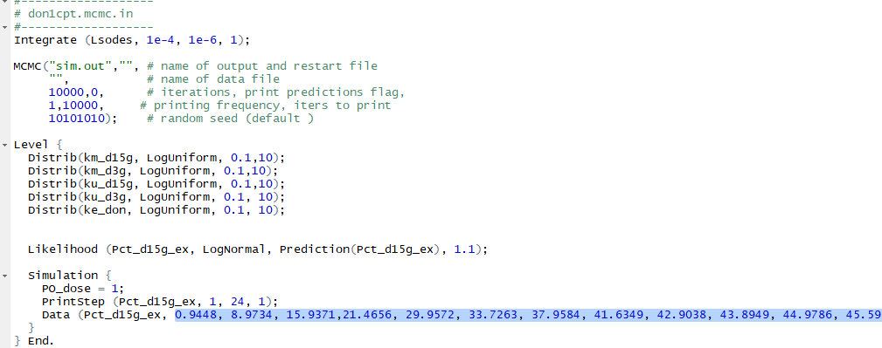
Excretion
Ke_Don
Km_d3g
Ku_d3g
DON
DON
D3G
Excretion
Ku_d15g
Km_d15g
D15G

Slide 3
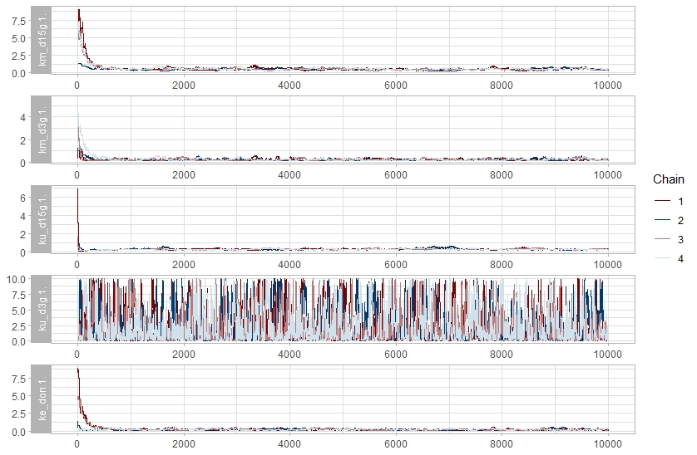

Slide 4
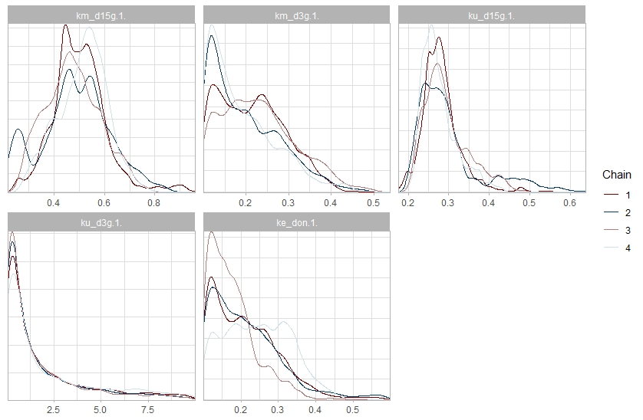

Slide 5
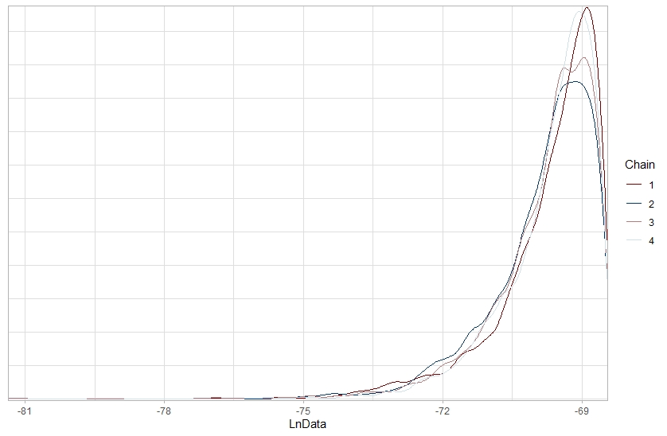

Slide 6
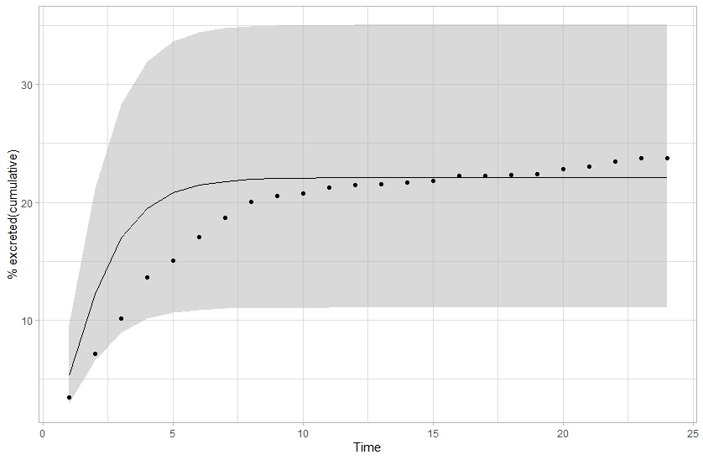
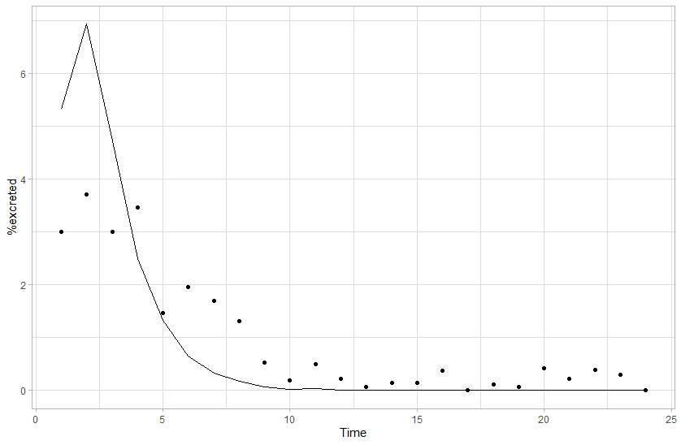
Excreted DON

Slide 7
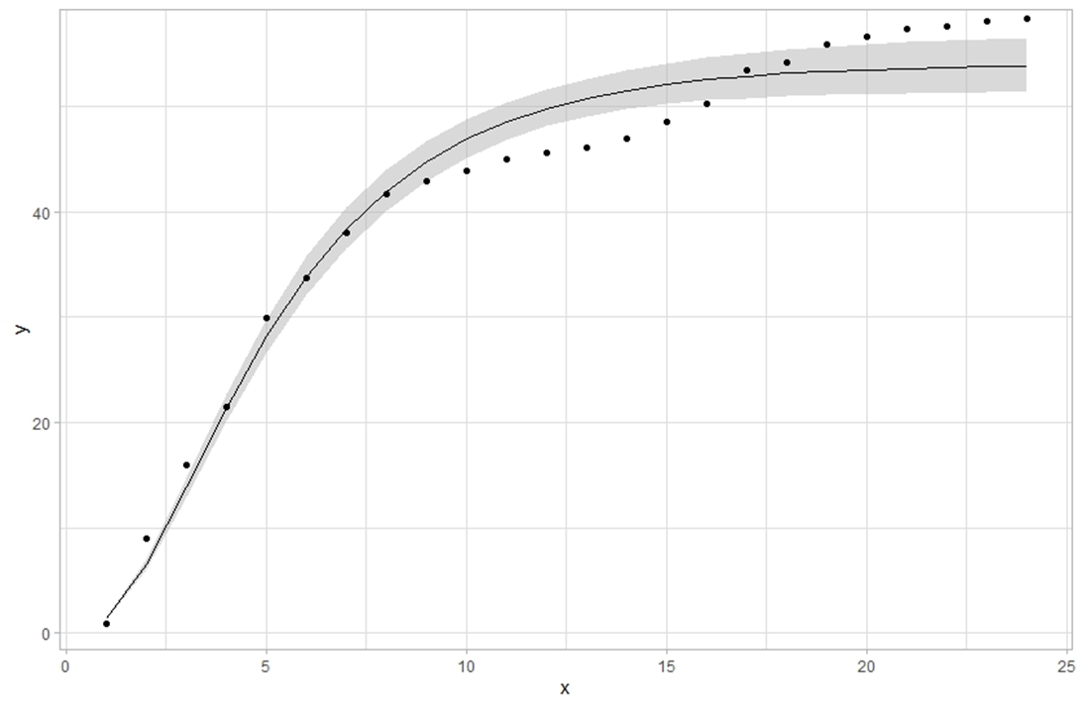
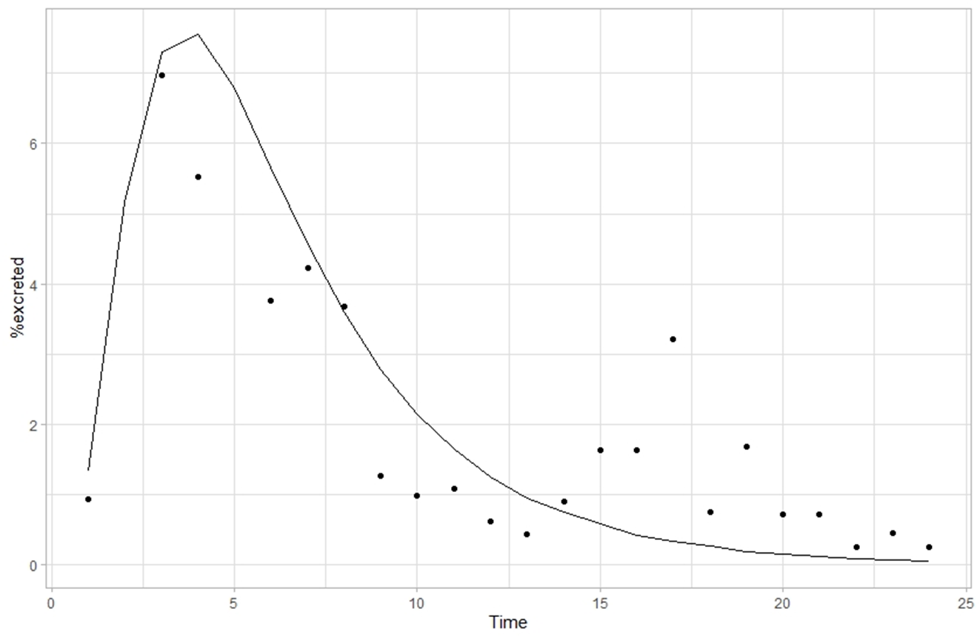
% excreted d15g (cumulative)
Excreted D15G
D15G
Time

Slide 8
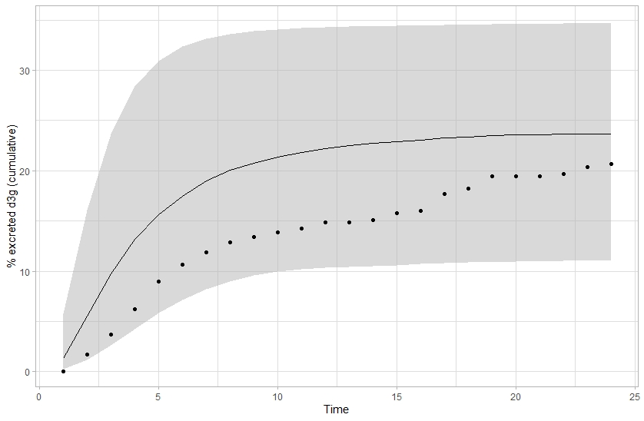
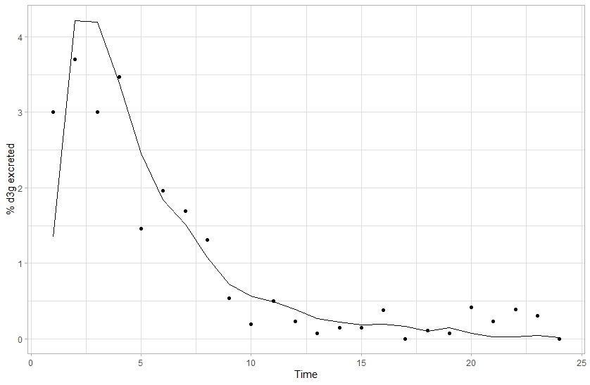
Excreted D3G

Slide 9
PBPK modeling of bioactivation and detoxification of methyleugenol in human
Yu-Syuan Luo

Slide 11
 | mean | Pct_90 | Pct_95 | Pct_99 | CSAF90 | CSAF95 | CSAF99
Q_MEO_1.1 | 0.105594 | 0.155269 | 0.172055 | 0.206048 | 1.470442 | 1.629408 | 1.95133
Q_3DMPOH_1.1 | 0.010111 | 0.014799 | 0.016436 | 0.020303 | 1.463674 | 1.625593 | 2.008081
Q_2HDME_1.1 | 0.000994 | 0.001454 | 0.001615 | 0.001995 | 1.463674 | 1.625589 | 2.008073
Q_1EU_1.1 | 0.029237 | 0.05459 | 0.062988 | 0.080264 | 1.867186 | 2.154405 | 2.745315
Q_3HMA_1.1 | 0.000791 | 0.001158 | 0.001286 | 0.001589 | 1.463667 | 1.625594 | 2.008074
Q_1HMES_1.1 | 0.004465 | 0.01492 | 0.020439 | 0.034064 | 3.341206 | 4.577156 | 7.62855
Q_1HMEG_1.1 | 0.000195 | 0.000488 | 0.000613 | 0.000895 | 2.49823 | 3.135108 | 4.580671
Q_1OME_1.1 | 0.035495 | 0.06522 | 0.07534 | 0.094655 | 1.837425 | 2.122523 | 2.666676

